Slide 1




Slide 2
filter for restaurants
remove NA and unnecessary data
Reduce from 7 million to 500.000
Mongo
csv’s
Review
low overall accuracy <0.5 for all learning models
Accuracy for 1 and 5 stars mostly >75%
Relatively low number 2 and 3 stars
Problem
language and words used in reviews often do not reflect the stars given
Data
Yelp academic dataset
Python
Emotion Models
Emolex
Vader
Python
Learning Models
Logistics Regression
Random Forrest
Naïve-Bayes
Adjust
Use star rating based on 3 bins
positive
Neutral
negative
Export joblib files
Review
learning models’ accuracy improves to >0.75

Slide 3
VADER (Valence Aware Dictionary and sEntiment Reasoner)
A lexicon and rule-based sentiment analysis tool that is specifically attuned to sentiments expressed in social media ¹.
It is fully open-sourced under the MIT License ¹.
VADER uses a set of rules to specify a mathematical model without explicitly coding it.
VADER detects the polarity of sentiment (how positive or negative) of a given body of text even when the data being analyzed is unlabelled
Naive Bayes
A supervised machine learning algorithm based on Bayes’ theorem. It is a probabilistic classifier used in NLP tasks like sentiment analysis.
Naive Bayes is the often regarded as the simplest and fastest classification algorithm for a large chunk of data.
In various applications such as spam filtering, text classification, sentiment analysis, and recommendation systems, Naive Bayes classifier is used successfully
Random Forrest
Random Forest is a machine learning algorithm that can be used for sentiment analysis. It involves some form of data mining process to get the text that will later be carried out the learning process in the machine learning that will be built 123.
For example, one study conducted a sentimental analysis with data sources from Twitter using the Random Forest algorithm approach 123. The evaluation results of the algorithm were measured in this study 123.
Linear Support Vector Machine (SVM)
A supervised learning algorithm used for classification tasks.
It works by finding the hyperplane that best separates the data into different classes. The hyperplane is chosen to maximize the margin between the classes, which is defined as the distance between the hyperplane and the closest data points from each class. These closest points are called support vectors, and they are the only points that contribute to defining the hyperplane.
Linear SVMs are similar to other SVMs with a linear kernel, but they are implemented using a different library (liblinear instead of libsvm) which makes them more flexible in terms of the choice of penalties and loss functions and allows them to scale better to large numbers of samples.

Slide 4
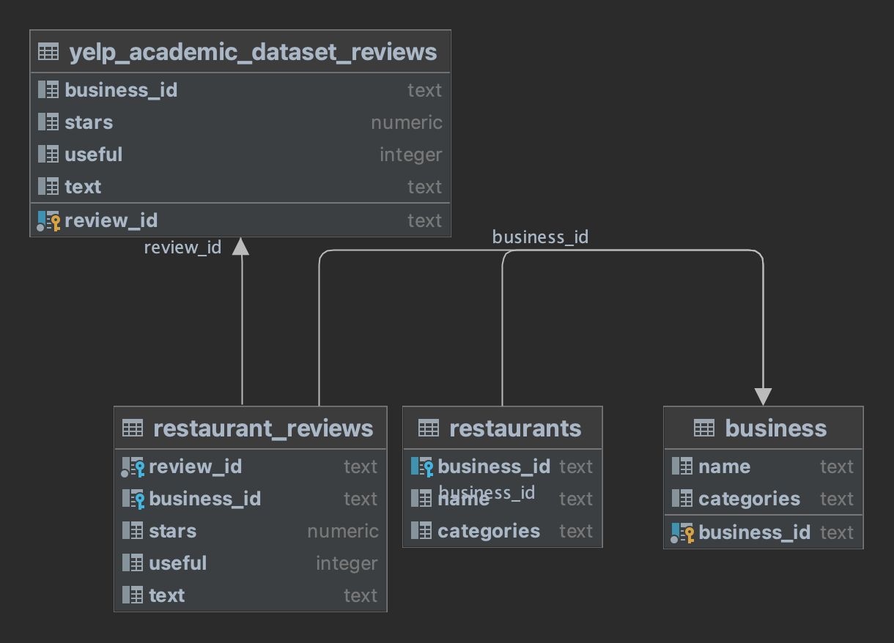
select * from business where categories like '%Restaurants%' select * from yelp_academic_dataset_reviews join restaurants r on yelp_academic_dataset_reviews.business_id = r.business_id select * from estaurant_reviewsr where useful > 1

Slide 5
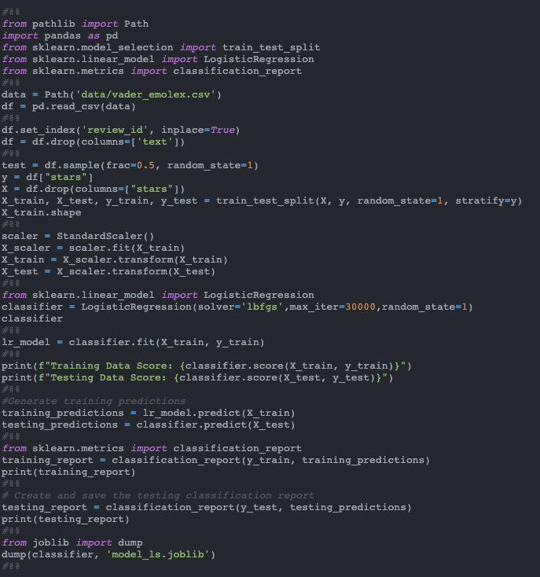
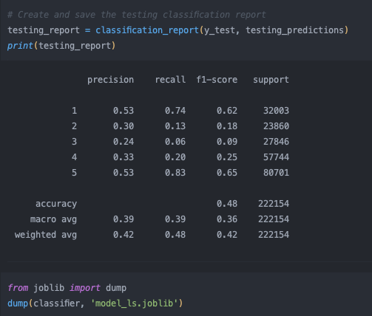
Linear Regression

Slide 6
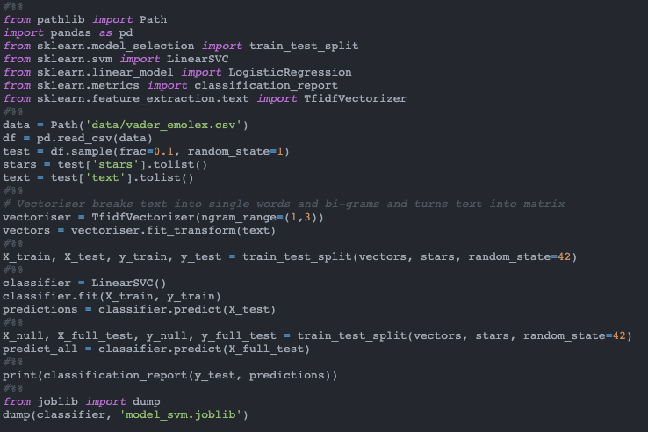
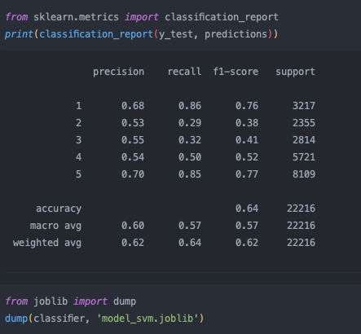
Linear Support Vector

Slide 7
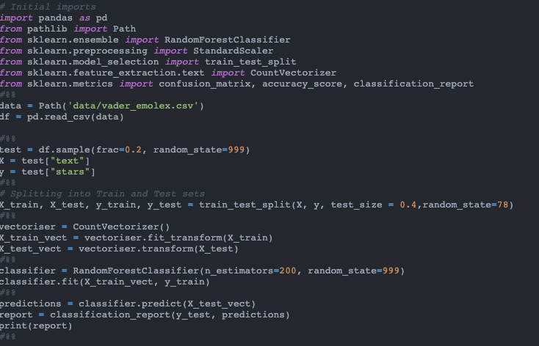
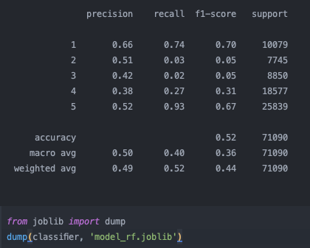
Random Forrest

Slide 8
special thanks go to the following people
for teaching us the impossible
Van
Shamal
Roy
Ramida
Josh
for all your support
Rachel
Appoline
Amanda
for joining us during this journey
Laszlo Dom Minh Eloise
Johnny Asal Khin Ina
Zakia Anush Mark Gavin
Thelge Yaqoob Timo Ray
Ang Deon Josh Usama
Neha Hassan Lachlan Rohan
Dhiraj Anjana Laura Javier
Deepesh Hem Akbar Bel
for artwork
David Pupaza
and last but not least
LASZLO’s PYTHON PC

